Slide 1
Network Structure Learning

Slide 2
Categories
Neural Architecture
Search
Bayesian Network Structure Learning
Knowledge Distillation
Network Compression in Learning Objective

Slide 3
Neural Architecture Search

Slide 4
Why Neural Architecture Search?
Currently employed architectures have mostly been developed manually by human experts, which is a time-consuming and error prone process. Because of this, there is growing interest in automated neural architecture search methods.

Slide 5
Three Dimensions
Search Space. The search space defines which architectures can be represented in principle. Incorporating prior knowledge about typical properties of architectures well-suited for a task can reduce the size of the search space and simplify the search. However, this also introduces a human bias, which may prevent finding novel architectural building blocks that go beyond the current human knowledge.

Slide 6
Search Strategy. The search strategy details how to explore the search space (which is often exponentially large or even unbounded). On the one hand, it is desirable to find well-performing architectures quickly, while on the other hand, premature convergence to a region of suboptimal architectures should be avoided.
Performance Estimation Strategy. The objective of NAS is typically to find architectures that achieve high predictive performance on unseen data. Performance estimation refers to the process of estimating this performance: the simplest option is to perform a standard training and validation of the architecture on data, but this is unfortunately computationally expensive and limits the number of architectures that can be explored. Much recent research therefore focuses on developing methods that reduce the cost of these performance estimations.

Slide 7
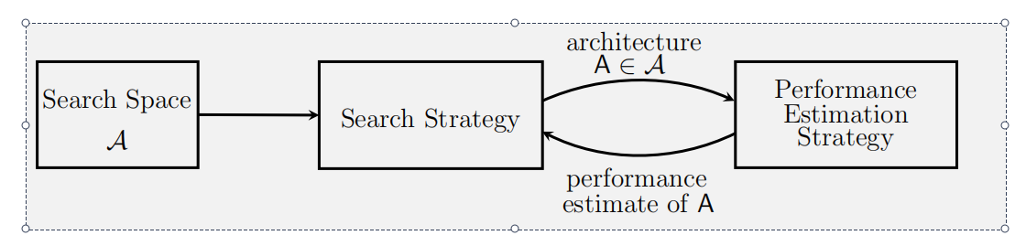
Abstract illustration of NAS methods. A search strategy selects an architecture A from a predefined search space A. The architecture is passed to a performance estimation strategy, which returns the estimated performance of A to the search strategy.

Slide 8
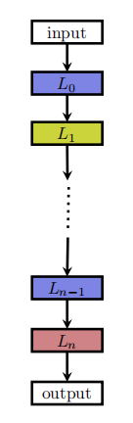
Search Space
a. global search spaces
A relatively simple search space is the space of chain-structured neural networks. A chain-structured neural network architecture A can be written as a sequence of n layers, where the i’th layer Li receives its input from layer i-1 and its output serves as the input for layer i+1.

Slide 9
The search space is parametrized by: (1) the (maximum) number of layers n (possibly unbounded); (2) the type of operation every layer executes, e.g., pooling, convolution; (3) hyperparameters associated with the operation, e.g., number of filters, kernel size and strides for a convolutional layer, or simply a number of units for fully-connected networks. Note that the parameters from (3) are conditioned on (2).
[1] Fran¸cois Chollet. Xception: Deep learning with depthwise separable convolutions. arXiv:1610.02357, 2016.
[2] Bowen Baker, Otkrist Gupta, Nikhil Naik, and Ramesh Raskar. Designing neural network architectures using reinforcement learning. In International Conference on Learning Representations, 2017a.
[3] Han Cai, Tianyao Chen, Weinan Zhang, Yong Yu, and Jun Wang. Effiffifficient architecture search by network transformation. In Association for the Advancement of Artifificial Intelligence, 2018a.

Slide 10
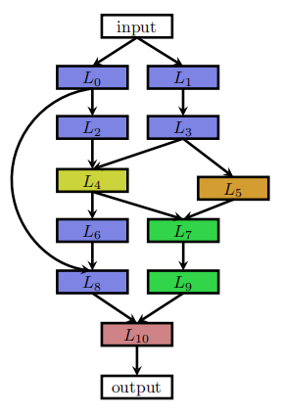
Recent work on NAS incorporates modern design elements known from hand-crafted architectures, such as skip connections, which allow for building complex, multi-branch networks. In this case the input of layer i can be formally described as a function gi (Li-1-out , . . . , L0-out ) combining previous layer outputs. Employing such a function results in significantly more degrees of freedom.
Global search spaces is computationally expensive.
[4] Thomas Elsken, Jan Hendrik Metzen, and Frank Hutter. Efficient multi-objective neural architecture search via lamarckian evolution. In International Conference on Learning Representations, 2019.
[5] Esteban Real, Alok Aggarwal, Yanping Huang, and Quoc V. Le. Aging Evolution for Image Classifier Architecture Search. In AAAI, 2019.

Slide 11
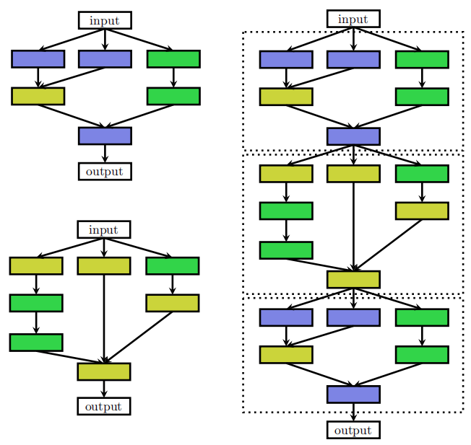
b. cell-based search space
[6] Barret Zoph, Vijay Vasudevan, Jonathon Shlens, and Quoc V. Le. Learning transferable architectures for scalable image recognition. In Conference on Computer Vision and Pattern Recognition, 2018.
optimize two kinds of cells: a normal cell that preserves the dimensionality of the input and a reduction cell that reduces the spatial dimension. The final architecture is then built by stacking these cells in a predefined manner.
1. The size of the search space is drastically reduced since cells usually consist of significantly less layers than whole architectures.
2. Architectures built from cells can more easily be transferred or adapted to other datasets by simply varying the number of cells and filters used within a model.
3. Creating architectures by repeating building blocks has proven a useful design principle in general, such as repeating an LSTM block in RNNs or stacking a residual block.

Slide 12
Search Strategy
Many different search strategies can be used to explore the space of neural architectures, including random search, Bayesian optimization, evolutionary methods, reinforcement learning (RL), and gradient-based methods.
NAS became a mainstream research topic in the machine learning community after Zoph & Le obtained competitive performance on the CIFAR-10 and Penn Treebank benchmarks with a search strategy based on reinforcement learning. While Zoph and Le (2017) used vast computational resources to achieve this result (800 GPUs for three to four weeks).
[7] Barret Zoph and Quoc V. Le. Neural architecture search with reinforcement learning. In International Conference on Learning Representations, 2017.

Slide 13
a. Reinforcement learning
To frame NAS as a reinforcement learning (RL) problem, the generation of a neural architecture can be considered to be the agent’s action, with the action space identical to the search space. The agent’s reward is based on an estimate of the performance of the trained architecture on unseen data (see Performance Estimation Strategy). Different RL approaches differ in how they represent the agent’s policy and how they optimize it.
Cai et al. frame NAS as a sequential decision process: in their approach, the state is the current (partially trained) architecture, the reward is an estimate of the architecture’s performance, followed by a training phase of the network.
[8] Han Cai, Tianyao Chen, Weinan Zhang, Yong Yu, and Jun Wang. Efficient architecture search by network transformation. In Association for the Advancement of Artificial Intelligence, 2018a.

Slide 14
b. Evolutionary algorithms
An alternative to using RL is neuro-evolutionary approaches that use evolutionary algorithms for optimizing the neural architecture.
Miller et al. use genetic algorithms to propose architectures and use backpropagation to optimize their weights. Many neuro-evolutionary approaches since then use genetic algorithms to optimize both the neural architecture and its weights; however, when scaling to contemporary neural architectures with millions of weights for supervised learning tasks, SGD-based weight optimization methods currently outperform evolutionary ones.
[9] G.F. Miller, P.M. Todd, and S.U Hedge. Designing neural networks using genetic algorithms. In 3rd International Conference on Genetic Algorithms (ICGA’89), 1989.

Slide 15
More recent neuro-evolutionary approaches use gradient-based methods for optimizing weights and solely use evolutionary algorithms for optimizing the neural architecture itself.
Evolutionary algorithms evolve a population of models, i.e., a set of networks; in every evolution step, at least one model from the population is sampled and serves as a parent to generate offspring by applying mutations to it. Mutations are local operations, such as adding or removing a layer, altering the hyperparameters of a layer, adding skip connections, as well as altering training hyperparameters. After training the offspring, their fitness (e.g., performance on a validation set) is evaluated and they are added to the population.
[10] Hanxiao Liu, Karen Simonyan, Oriol Vinyals, Chrisantha Fernando, and Koray Kavukcuoglu. Hierarchical Representations for Efficient Architecture Search. In Interna tional Conference on Learning Representations, 2018b.
[11] Esteban Real, Alok Aggarwal, Yanping Huang, and Quoc V. Le. Aging Evolution for Image Classifier Architecture Search. In AAAI, 2019.
[12] Thomas Elsken, Jan Hendrik Metzen, and Frank Hutter. Efficient multi-objective neural architecture search via lamarckian evolution. In International Conference on Learning Representations, 2019.

Slide 16
Real et al. remove the worst individual from a population, while Real et al. found it beneficial to remove the oldest individual (which decreases greediness).
Real et al. conduct a case study comparing RL, evolution, and random search (RS), concluding that RL and evolution perform equally well in terms of final test accuracy, with evolution having better anytime performance and finding smaller models.
[13] Esteban Real, Sherry Moore, Andrew Selle, Saurabh Saxena, Yutaka Leon Suematsu, Quoc V. Le, and Alex Kurakin. Large-scale evolution of image classifiers. International Conference on Machine Learning, 2017.

Slide 17
c. Bayesian optimization
Bayesian optimization (BO) is one of the most popular methods for hyperparameter optimization, but it has not been applied to NAS since typical BO toolboxes are based on Gaussian processes and focus on low dimensional continuous optimization problems.
Liu et al. propose a continuous relaxation to enable direct gradient-based optimization: instead of fixing a single operation oi (e.g., convolution or pooling) to be executed at a specific layer, the authors compute a convex combination from a set of operations {o1, . . . , om}. More specifically, given a layer input x, the layer output y is computed as where the convex coefficients αi effectively parametrize the network architecture. Liu et al. then optimize both the network weights and the network architecture by alternating gradient descent steps on training data for weights and on validation data for architectural parameters such as α.
Eventually, a discrete architecture is obtained by choosing the operation for every layer.
[14] Hanxiao Liu, Karen Simonyan, and Yiming Yang. DARTS: Differentiable architecture search. In International Conference on Learning Representations, 2019b.

Slide 18
Performance Estimation Strategy
The search strategies discussed in Space Strategy aim at finding a neural architecture A that maximizes performance measure, such as accuracy on unseen data.
To guide their search process, performance estimation strategies need to estimate the performance of a given architecture A. The simplest way of doing this is to train A on training data and evaluate its performance on validation data.
However, training each architecture to be evaluated from scratch frequently yields computational demands in the order of thousands of GPU days for NAS.

Slide 19
Performance can be estimated based on lower fidelities of the actual performance after full training. Such lower fidelities include shorter training times, training on a subset of the data or with less filters per layer and less cells. While these low-fidelity approximations reduce the computational cost, they also introduce bias in the estimate as performance will typically be underestimated.
Another possible way of estimating an architecture’s performance builds upon learning curve extrapolation. Domhan et al. propose to extrapolate initial learning curves and terminate those predicted to perform poorly to speed up the architecture search process.
[15] Arber Zela, Aaron Klein, Stefan Falkner, and Frank Hutter. Towards automated deep learning: Efficient joint neural architecture and hyperparameter search. In ICML 2018 Workshop on AutoML (AutoML 2018), 2018.
[16] T. Domhan, J. T. Springenberg, and F. Hutter. Speeding up automatic hyperparameter optimization of deep neural networks by extrapolation of learning curves. In Proceedings of the 24th International Joint Conference on Artifificial Intelligence (IJCAI), 2015.

Slide 20
Another approach to speed up performance estimation is to initialize the weights of novel architectures based on weights of other architectures that have been trained before. One way of achieving this, dubbed network morphisms, allows modifying an architecture while leaving the function represented by the network unchanged, resulting in methods that only require a few GPU days. This allows for increasing the capacity of networks successively and retaining high performance without requiring training from scratch.
An advantage of these approaches is that they allow search spaces without an inherent upper bound on the architecture’s size; on the other hand, strict network morphisms can only make architectures larger and may thus lead to overly complex architectures. This can be attenuated by employing approximate network morphisms that allow shrinking architectures.
[17] Tao Wei, Changhu Wang, Yong Rui, and Chang Wen Chen. Network morphism. In International Conference on Machine Learning, 2016.
[18] Thomas Elsken, Jan Hendrik Metzen, and Frank Hutter. Simple And Efficient Architecture Search for Convolutional Neural Networks. In NIPS Workshop on Meta-Learning, 2017.
[19] Thomas Elsken, Jan Hendrik Metzen, and Frank Hutter. Efficient multi-objective neural architecture search via lamarckian evolution. In International Conference on Learning Representations, 2019.

Slide 21
Discovering Neural Wirings
Even in methods of neural architecture search (NAS) the network connectivity patterns are largely constrained.
We relax the typical notion of layers and instead enable channels to form connections independent of each other. This allows for a much larger space of possible networks. The wiring of our network is not fixed during training – as we learn the network parameters we also learn the structure itself.
As NAS becomes more fine-grained, finding a good architecture is akin to finding a sparse subnetwork of the complete graph. Accordingly, DNW provides an effective mechanism for discovering sparse subnetworks of predefined architectures in a single training run.
[14] Wortsman M, Farhadi A, Rastegari M. Discovering neural wirings[J]. Advances in Neural Information Processing Systems, 2019, 32.

Slide 22
In this work, we consider an unconstrained set of possible wirings by allowing channels to form connections independent of each other. This enables us to discover a wide variety of operations (e.g. depthwise separable convs, channel shuffle and split, and more). Formally, we treat the network as a large neural graph where each node processes a single channel.
One key challenge lies in searching the space of all possible wirings – the number of possible sub-graphs is combinatorial in nature. When considering thousands of nodes, traditional search methods are either prohibitive or offer approximate solutions. Our method searches the space of all possible wirings with a simple modification of the backward pass.
First, consider the sole constraint that the total number of edges in the neural graph is fixed to be k. Initially we randomly assign a weight to each edge. We then choose the weighted edges with the highest magnitude and refer to the remaining edges as hallucinated. As we train, we modify the weights of all edges according to a specified update rule.

Slide 23
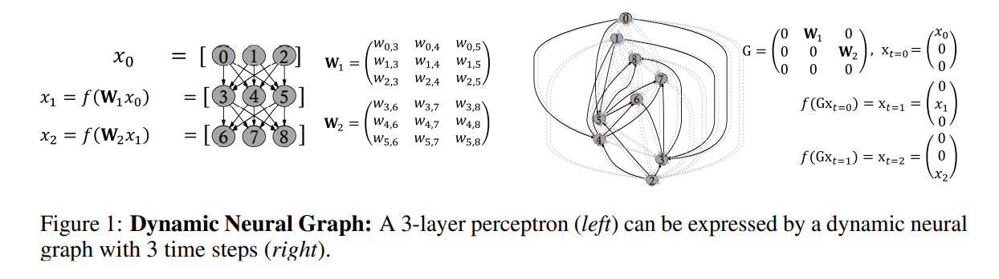
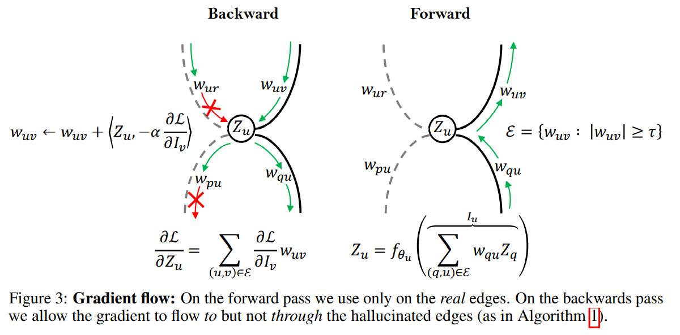

Slide 24
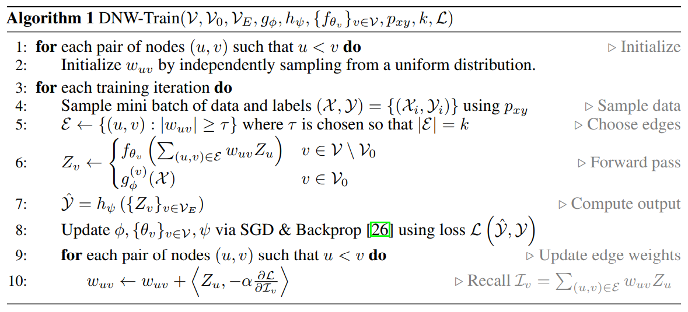

Slide 25
Deep Elastic Networks with Model Selection
we consider the problem of instance-wise dynamic network model selection for multi-task learning. The proposed method consists of an estimator and a selector.
The estimator is based on a backbone architecture and structured hierarchically. It can produce multiple different network models of different configurations in a hierarchical structure.
The selector chooses a model dynamically from a pool of candidate models given an input instance. The selector is a relatively small-size network consisting of a few layers, which estimates a probability distribution over the candidate models when an input instance of a task is given.
[15] Ahn C, Kim E, Oh S. Deep elastic networks with model selection for multi-task learning[C]//Proceedings of the IEEE/CVF international conference on computer vision. 2019: 6529-6538.

Slide 26
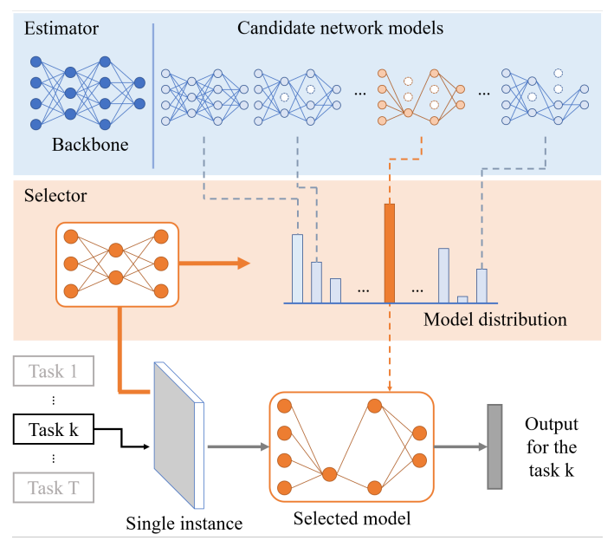
The estimator is based on a backbone (baseline) network, such as VGG or ResNet. It is structured hierarchically based on modularized blocks which consist of several convolution layers in the backbone network. It can produce multiple network models of different configurations and scales in a hierarchy.
The selector is a relatively small network compared to the estimator and outputs a probability distribution over candidate network models for a given instance. The model with the highest probability is chosen by the selector from a pool of candidate models to perform the task.

Slide 27
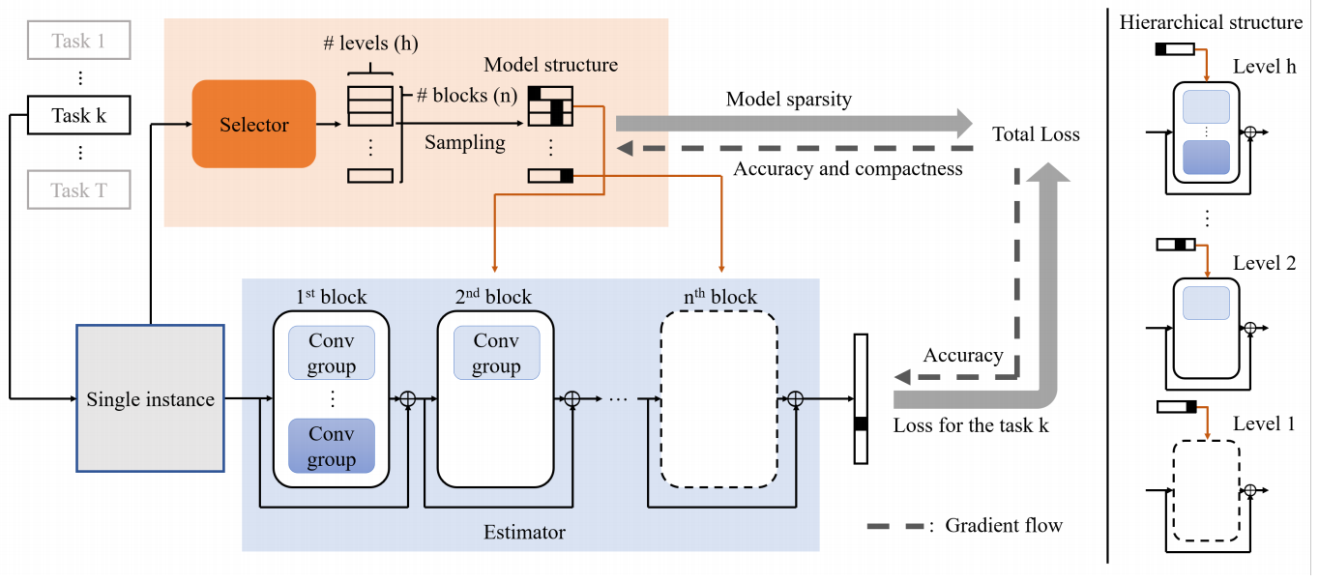
The estimator, whose structure is identical to the backbone network, contains n disjoint blocks. To simplify the hierarchical structure of each block, convolution layers in each block are divided into multiple groups. Lower levels of the hierarchy contain fewer convolution groups and higher levels contain more groups. The estimator can produce different network models by selecting convolution groups from zero to all groups in every block.
The selector outputs a probability distribution over the convolution groups in every block, and a network model is determined from the distribution. The overall loss function consists of a prediction loss term (e.g., cross-entropy) from the determined network model and a sparse regularization term.

Slide 28
ReNAS: Relativistic Evaluation of Neural Architecture Search
To save computational cost, most of existing NAS algorithms often train and evaluate intermediate neural architectures on a small proxy dataset with limited training epochs. But it is difficult to expect an accurate performance estimation of an architecture in such a coarse evaluation way.
This paper advocates a new neural architecture evaluation scheme, which aims to determine which architecture would perform better instead of accurately predict the absolute architecture performance. Therefore, we propose a relativistic architecture performance predictor in NAS (ReNAS). We encode neural architectures into feature tensors, and further refining the representations with the predictor.
[16] Xu Y, Wang Y, Han K, et al. Renas: Relativistic evaluation of neural architecture search[C]//Proceedings of the IEEE/CVF Conference on Computer Vision and Pattern Recognition. 2021: 4411-4420.

Slide 29
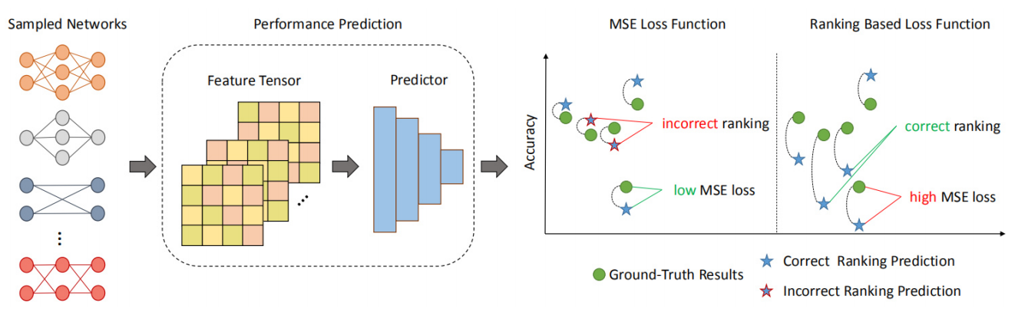
Sampled Networks: Architectures are sampled from the pre-defined search space and trained until converge to get the ground-truth results.
Performance Prediction: Sampled architectures are encoded into feature tensors by leveraging the adjacency matrix and features that can well represent the computational power. Then, a predictor is used to predict the final accuracy.
Loss Function. The pairwise ranking based loss function is used to train the predictor. Compared to mean squared error (MSE) loss, ranking based loss function may derive a prediction that is far from the ground-truth but in the correct ranking position, which is crucial to the following searching algorithms to search for the best architecture.

Slide 30
Search space: we use NAS Bench-101 dataset as an example, which contains over 423k unique CNN architectures and their train, validation and test accuracies on CIFAR-10 dataset.
Feature tensor: the cell can be represented by a 0-1 adjacency matrix A ∈ {0, 1}^n×n and a type vector t ∈ {1, · · ·, 5}^n (5 different node types containing input, 3×3 conv, 1×1 conv, 3×3 max-pooling and output), in which n is the number of nodes. Furthermore, we calculate FLOPs and parameters of each node and derive a FLOP vector f∈R^n (we assume the input image size is 32 × 32) and a parameter vector p∈R^n. Since the number of nodes may be different in each cell, we pad the adjacency matrix A with 0 and the size is fixed as 7×7. The type vector t, FLOP vector f and parameter vector p are padded accordingly. After that, we broad cast the vectors into matrices, and make an element-wise multiplication with the adjacency matrix to get the type matrix T, FLOP matrix F and parameter matrix P, and finally concatenate them together to get a 19 × 7 × 7 tensor T to represent a specific architecture in NAS-Bench-101.

Slide 31





architecture performance predictor: When training the predictor, a commonly used loss function is element-wise MSE or L1 loss function. They assume that a lower MSE or L1 loss leads to a better ranking results. However, this is not always the case. For example, given two networks with ground-truth classification accuracies of 0.9 and 0.91 on the validation set. In the first circumstance, they are predicted to have accuracies of 0.91 and 0.9, and in the second circumstance of 0.89 and 0.92. MSE losses are the same in both situations, but the former is worse since the ranking between two networks is changed and the architecture with worse performance will be selected by the searching methods. We believe that the rankings of predicted accuracies between different architectures are more important than their absolute performance when applying network performance predictor to different searching methods. Formally, given n different network architectures and their ground-truth performance and is the output of the predictor (short as which are the n objects to be ranked. We define the pairwise ranking based loss function as:
Where is hinge function with parameter a.

Slide 32
Bayesian Network Structure Learning

Slide 33
A Bayesian Network (BN) is a type of a probabilistic graphical model introduced by Pearl to support reasoning under uncertainty. probability theory provides a means to articulate and manipulate key relationships used in human reasoning: likelihood, conditionality, relevance, and causality. Bayesian Networks combine probability theory with graph theory and causality to provide a mechanism to answer queries such as “what will be the likely effect of this intervention?” or “what factors are relevant to this effect?”.
[1] Pearl, J. (1985). Bayesian Networks: A model of self-activated memory for evidential reasoning. In Proceedings of the 7th Conference of the Cognitive Science Society, pp. 329–334.

Slide 34


A Bayesian Network, ℬ , is defined by a tuple consisting of a Directed Acyclic Graph (DAG) 𝐺, and a set of parameters 𝚯, defining the strength and the shape of the relationships between variables :
The DAG, 𝐺, consists of a set of nodes (also known as vertices) 𝑿, each of which corresponds to one of the 𝑛 variables under consideration, 𝑿 = {𝑋1, … ,𝑋𝑛}, and a set of directed edges (or arcs) 𝑬, so that:
A directed edge, for example 𝐴 ⟶ 𝐵, represents a direct conditional relationship between 𝐴 and 𝐵, or under a causal assumption, means that 𝐴 is a direct cause of 𝐵. If we make this causal assumption, then the BN is a unique DAG that enables us to reason about intervention. Where we have a directed edge 𝐴 ⟶ 𝐵 in a graph, we say that 𝐴 is a parent of 𝐵, or equivalently, 𝐵 is a child of 𝐴.

Slide 35
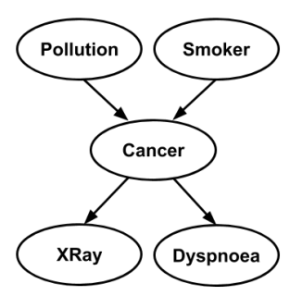

Above Figure shows a DAG representing a simple model of two causes of (lung) cancer and two effects of cancer. It encapsulates the relationships between the variables, in particular the conditional dependencies and independencies between the variables. Conditional probability tells us, for example, the probability that the person will have a cloudy X-ray given that we know they have Cancer, written as 𝑃(𝑋𝑅𝑎𝑦 | 𝐶𝑎𝑛𝑐𝑒𝑟)1 where “|” means “given”. Conditional independence tells us which variables are irrelevant to that probability. For example,
tells us that the probability of a cloudy X-Ray is independent of whether Smoker is true given that we know the person has Cancer. The symbol “⟘” means “is independent of” and so this is written as:

Slide 36
Constructing Deep Neural Networks by Bayesian Network Structure Learning
We propose a new interpretation for depth and inter-layer connectivity where conditional independencies in the input distribution are encoded hierarchically in the network structure. Thus, the depth of the network is determined inherently. The proposed method casts the problem of neural network structure learning as a problem of Bayesian network structure learning. Then, instead of directly learning the discriminative structure, it learns a generative graph, constructs its stochastic inverse, and then constructs a discriminative graph.
[2] Rohekar R Y , Nisimov S , Koren G , et al. Constructing Deep Neural Networks by Bayesian Network Structure Learning[J]. Advances in Neural Information Processing Systems, 2018

Slide 37
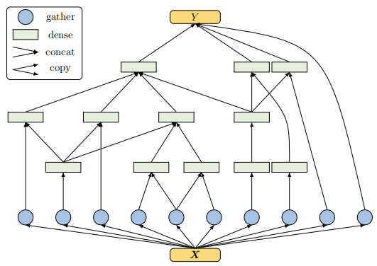
An example of a learned structure, for MNIST
We let a hierarchy of independence in the input distribution encoded in a deep generative graph, where lower-order independencies are encoded in deeper layers. Thus, the number of layers is automatically determined, which is a desirable virtue in any architecture learning method. We then convert the generative graph into a discriminative graph, demonstrating the ability of the latter to mimic (preserve conditional dependencies) of the former. In the resulting structure, a neuron in a layer is allowed to connect to neurons in deeper layers skipping intermediate layers.
Our proposed algorithm learns in an unsupervised manner. The resulting structures encode a hierarchy of independencies in the input distribution, where a node in one layer may connect to another node in any deeper layer, and network depth is determined automatically.

Slide 38



An example of a learned structure, for MNIST

Slide 39
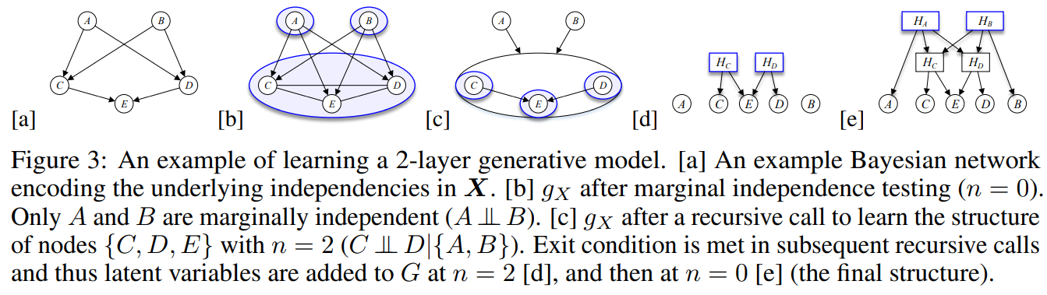
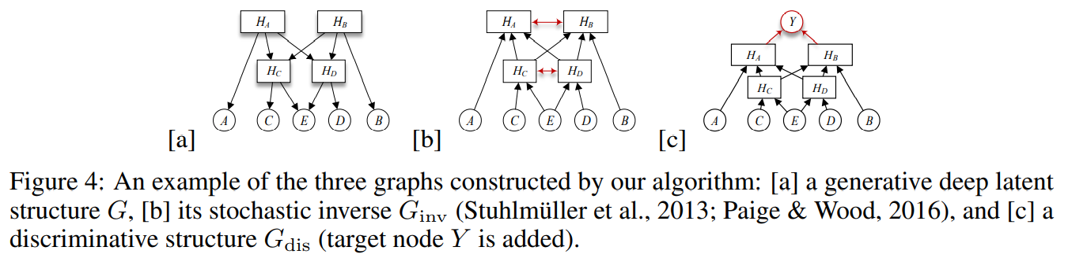


Slide 40
Knowledge Distillation

Slide 41
Why Knowledge Distillation (KD)?
Since the limited computing capacity and memory of mobile devices, deploying deep models in mobile devices and embedded systems is a huge challenge.
To develop efficient deep models, recent works usually focus on 1) efficient building blocks for deep models, including depthwise separable convolution, as in MobileNets; and 2) model compression.

Slide 42
Knowledge distillation: these methods extract knowledge from a larger deep neural network into a smaller network.
The first proposal model compression is proposed to transfer information from large models or models to training small models without significantly led to a decline in accuracy. Learn a small model from a large model and later promoted as knowledge distillation [1]. In knowledge distillation, small student models are usually supervised by large teachers models.
Main ideas: Student models imitate the teacher model to gain competition or even superior performance.
Key issues: How to transfer knowledge from the teacher mode to the primary school student mode.
Knowledge distillation system is basically composed of three key parts: knowledge, distillation algorithm and teacher -student architecture.
[1] Hinton, G., Vinyals, O. & Dean, J. (2015). Distilling the knowledge in a neural network. arXiv preprint arXiv:1503.02531.

Slide 43
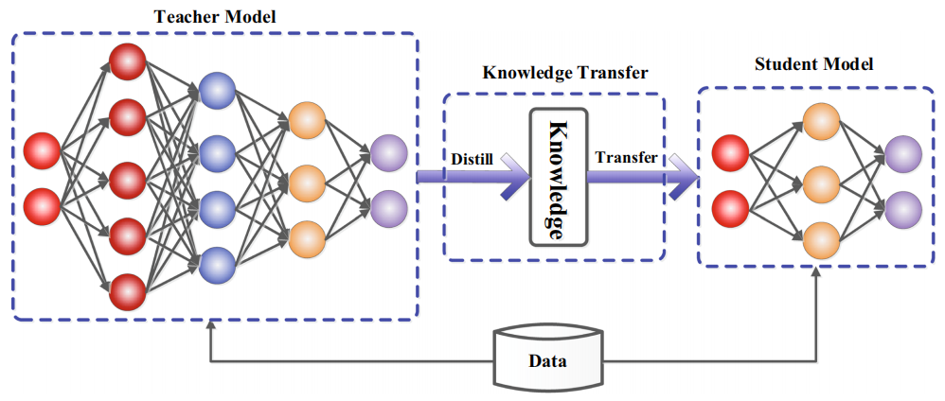
General teacher-student framework for knowledge distillation

Slide 44
PHUONG & LAMPERT obtained the theoretical basis for learning the rapid convergence of students in deep linear classifiers. It answered the content and speed of students’ learning, and revealed the factors that determine the success of distillation.
Successful distillation dependencies: the geometric shape, the optimization deviation of the distillation target, and the strong single tone of the student classifier.
The verification results show that: 1) The larger model may not be a better teacher due to the model capacity gap; 2) distillation has a adverse effect on students' learning.
Model compression knowledge distillation is similar to how humans learn. Inspired by this, the recent knowledge of knowledge and distillation has been expanded to teachers and students' learning, mutual learning, auxiliary teaching, lifelong learning, and self-learning.
[2] Phuong, M., & Lampert, C. H. (2019a). Towards understanding knowledge distillation. In ICML.
[3] Mirzadeh, S. I., Farajtabar, M., Li, A. & Ghasemzadeh, H. (2020). Improved knowledge distillation via teacher assistant. In AAAI.
[4] Zhang, Y., Xiang, T., Hospedales, T. M. & Lu, H. (2018b). Deep mutual learning. In CVPR.
[5] Mirzadeh, S. I., Farajtabar, M., Li, A. & Ghasemzadeh, H. (2020). Improved knowledge distillation via teacher assistant. In AAAI.
[6] Zhai, M., Chen, L., Tung, F., He, J., Nawhal, M. & Mori, G. (2019). Lifelong gan: Continual learning for conditional image generation. In ICCV.
[7] Yuan, L., Tay, F. E., Li, G., Wang, T. & Feng, J. (2020). Revisit knowl
edge distillation: a teacher-free framework. In CVPR.

Slide 45
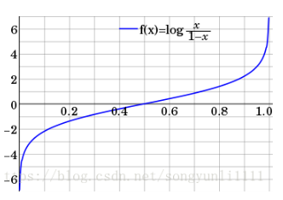
Knowledge
Ordinary knowledge distillation uses Logits with large depth models as teachers’ knowledge.
The activation, neurons, or characteristics of the middle layer can also be used as knowledge to guide the learning of student models.Different activists, neurons, or sample pairs include rich information learned by teachers' models.
Different forms of knowledge: response-based knowledge, characteristic knowledge, and relationship-based knowledge.
[8] Ahn, S., Hu, S., Damianou, A., Lawrence, N. D., & Dai, Z. (2019). Variational information distillation for knowledge transfer. In CVPR.
[9] Tung, F., & Mori, G. (2019). Similarity-preserving knowledge distillation. In ICCV.
[10] Liu, J., Wen, D., Gao, H., Tao, W., Chen, T. W., Osa, K., et al. (2019c).
Knowledge representing: effificient, sparse representation of prior knowledge for knowledge distillation. In CVPRW.

Slide 46
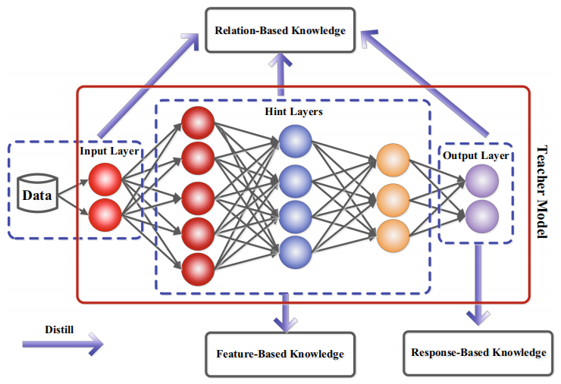
The intuitive example diagram of different categories of knowledge in the teacher model.

Slide 47
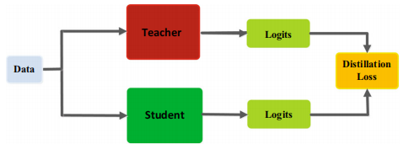
Response-based Knowledge usually refers to the nerve response of the last output layer of the teacher model. The main idea is to directly simulate the final prediction of the teacher model.
where L_{R}(.) indicates the divergence loss of logits, and z_{t} and z_{s} are logits of teacher and student, respectively. A typical response-based KD model is shown in the following figure.

Slide 48

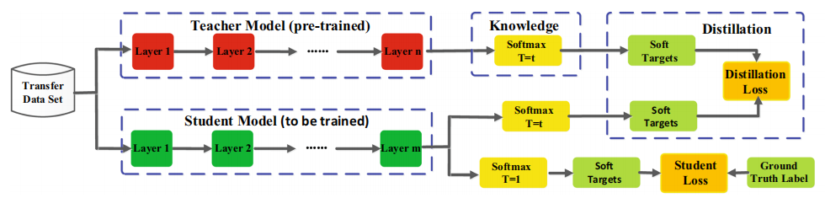
The most popular response-based image classification knowledge is called soft target. Specifically, the soft goal is to enter the probability of the class, which can be estimated to be:
where T is a temperature factor to control the importance of each soft target.
The figure below gives the benchmark model of Vanilla Knowledge Distillation, which is a combination of distillation and student losses.

Slide 49
The response-based knowledge is direct, and the effectiveness of the soft target is similar to smooth or regularized label. However, the response-based knowledge usually depends on the last layer of output.
Feature-based knowledge based on features: deep neural networks are good at learning multi-level characteristics as the abstraction increases, which is called learning. Therefore, for the output of the last layer and the output of the middle layer (that is, the feature diagram), it can be used as the knowledge of monitoring student model training. Specifically, characteristic knowledge from the middle layer is expanded for response-based knowledge, especially for the thinner and deeper networks.
The middle indicates that first introduce it in Fitnets to provide prompts to improve the training of student models. The main idea is to directly match the characteristics of teachers and students.
[11] Romero, A., Ballas, N., Kahou, S. E., Chassang, A., Gatta, C., & Bengio,
Y. (2015). Fitnets: Hints for thin deep nets. In ICLR.

Slide 50
Main ideas: directly match the characteristics of teachers and students.
Zagoruyko & komodakis derives a "attention map" from the original feature map to express knowledge. Kim et al. introduced the so-called "factor" as a more easy-to -understand intermediary form. In order to reduce the gap between teachers and students, Jin et al. proposed path constraint clue learning. The study can supervise the students through the output of the teacher's clue layer.
Generally speaking, the distillation loss of characteristic knowledge transfer can be expressed as
Among them, f_{t}(x) and f_{s}(x) are the characteristic charts of the middle layer of the teacher model and the student model, respectively. Change functions Φ_{t}(f_{t}(x)) and Φ_{s}(f_{s}(x)) are usually used in characteristic diagrams of teachers and student models (Shape). L_{F} (.) Means the similarity of the characteristic diagram of the characteristic diagram of the teacher-student model.
[12] Zagoruyko, S. & Komodakis, N. (2017). Paying more attention to attention: Improving the performance of convolutional neural networks via attention transfer. In ICLR.
[13] Kim, J., Park, S. & Kwak, N. (2018). Paraphrasing complex network: Network compression via factor transfer. In NeurIPS.

Slide 51
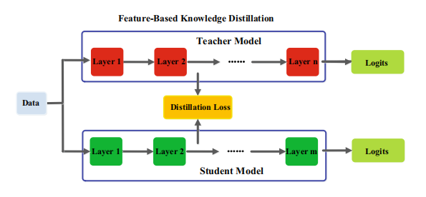
Feature -based knowledge distillation model diagram
Although the character transfer based on features provides good information for the learning of the student model, how to effectively choose the prompt layer from the teacher model and the guidance layer from the student model still need to be further studied. Because there are significant differences in the size of the prompt layer and the guidance layer, how to correctly match the characteristics of teachers and students also need to be explored.

Slide 52

Relation-based knowledge is further explored the relationship between different layers or data samples.
Yim et al. proposed a solution process process (FSP), which is defined by the gram (GRAM) matrix between two layers. The FSP matrix summarizes the relationship between feature mapping pairs. It uses the internal accumulation between the two layers of characteristics to calculate, and uses the correlation between the feature mapping as the extraction, and proposes the key information in the feature mapping through the knowledge distillation of the strange value decomposition (SVD).
Generally speaking, the distillation loss of relationship -based knowledge based on characteristic mapping relationships can be expressed as:
Among them, f_{t} and f_{s} are the characteristics of teacher models and student models. From the teacher model fˆ_{t} and fˇ_{t}, as well as the feature diagram selected in the student model fˆ_{s} and fˇ_{s}. Ψ_{t} (.) And Ψ_{s} (.) Are similar functions from the characteristic mapping pairs of teachers and student models. L_{R}¹ (.) Indicates that the relevant functions between the characteristics of the teacher and the student.
[14] Yim, J., Joo, D., Bae, J. & Kim, J. (2017). A gift from knowledge distillation: Fast optimization, network minimization and transfer learning. In CVPR.

Slide 53
Traditional knowledge transfer methods often involve the refinement of personal knowledge, and the personal soft goals of teachers are directly refined into students. In fact, refined knowledge includes not only characteristic information, but also the interrelationship between data samples.
Liu et al. proposes a effective knowledge distillation method that is effective through instance diagram. Peng et al. proposes a method of distillation based on the relevant residue. The distillation knowledge includes both instance level information and correlation between instances. Learn the correlation between instances.
Among them, (t_{i}，t_{j})∈F_{t} and (s_{i}，s_{j})∈F_{s}, F_{t} 和 F_{s} are the features of features from teachers and student models, respectively. ψ_{t} (.) and ψ_{s} (.) are similar functions of (t_{i}、t_{j}) and (s_{i}、s_{j}) . L_{R}² (.) is a function between teachers and student characteristics.

Slide 54
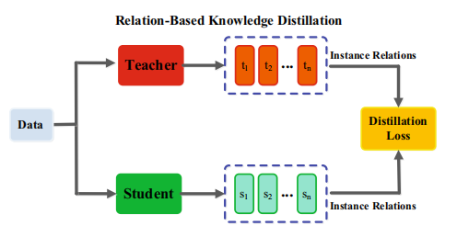
A typical relation-based knowledge distillation model diagram

Slide 55
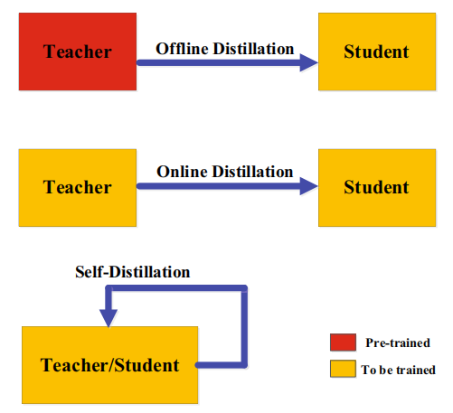
Distillation Schemes
According to whether the teacher model is updated at the same time as the student model, the learning scheme of knowledge distillation can be divided into three categories: offline distillation, online distillation, and self -distillation:

Slide 56
a. Offline Distillation
There are two stages of the entire training process: 1) First training the teacher model on a group of training samples, and then distilled; 2) Teacher model is used to extract knowledge in the form of Logits or intermediate features, and then used to guide during the distillation process for guidance training for student models.
The offline method mainly focuses on the different parts of knowledge transfer, including the design and matching features of knowledge or the loss function of the distribution matching.
The main advantage of offline methods is that they are simple and easy to implement. However, it cannot avoid complex large-capacity teacher models. The training time is huge, and the training of offline distilled middle student models is usually efficient under the guidance of the teacher model. Moreover, the gap between the ability between the big teachers and the elementary school students has always existed.

Slide 57
b. Online Distillation
In online distillation, the teacher model and the student model are updated at the same time, and the entire knowledge distillation framework is trained to the end-to-end.
Multiple neural networks work in a collaborative manner. In the training process, any network can be a student model, and other models can be a teacher.
Online distillation is a single-stage end-to-end training scheme with efficient parallel computing. However, existing online methods usually cannot solve high -capacity teachers in the online environment.
c. Self-Distillation
In self-distillation, the same networks are used for the teacher and the student models. This can be regarded as a special case of online distillation.
Zhang et al. proposed a new self-distillation method, in which knowledge from the deeper sections of the network is distilled into its shallow sections.
[15] Zhang, L., Song, J., Gao, A., Chen, J., Bao, C. & Ma, K. (2019b). Be your own teacher: Improve the performance of convolutional neural networks via self distillation. In ICCV.

Slide 58
Teacher–Student Architecture
The quality of the acquisition and refinement of students from teachers to students depends on how to design teachers and student networks. As far as human learning habits are concerned, we want a student to find a suitable teacher. Therefore, to complete the acquisition and refining of knowledge in the refinement of knowledge, how to choose or design the appropriate teacher -student structure is a very important but difficult issue. Recently, the models of teachers and students are almost fixed in the process of distillation, and the size and structure are unchanged, which can easily cause the model capacity gap.

Slide 59
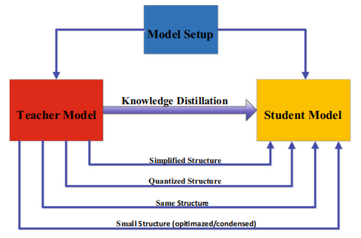
The complexity of deep neural networks mainly comes from two dimensions: depth and width. Generally, knowledge is needed to transfer knowledge from deeper and wider neural networks to lighter and thinner neural networks. Student networks are usually selected as: 1) Simplified versions of the teacher network, with a small number of layers and fewer channels for each layer; 2) the quantitative version of the teacher network that retains the network structure; 3) small networks with efficient basic operations; 4) Small networks with optimized global network structures; 5) the same network as teachers.
The relationship between teachers and student models

Slide 60
The model capacity gap between the model between large deep neural networks and small student neural networks will reduce the transfer of knowledge.
Mirzadeh et al. Introduced teacher assistants to reduce the training gap between the teacher model and the student model. Learns to learn the gap further, even if the auxiliary structure is used to learn residue. On the other hand, several recent methods have also focused on the structural differences between minimized student models and teacher models. For example, Polino et al. Combining network quantification with knowledge distillation, that is, the student model is a small quantization version of the teacher model. NOWAK & Corso proposed a structural compression method that involves transferring the knowledge of multi-layer learning to a single layer.
Inspired by the successful search (or NAS), the performance of small neural networks can be further improved through a global structural search based on effective meta-operations or blocks.
[14] Mirzadeh, S. I., Farajtabar, M., Li, A. & Ghasemzadeh, H. (2020).
Improved knowledge distillation via teacher assistant. In AAAI.
[15] Gao, M., Wang, Y., & Wan, L. (2021). Residual error based knowledge
distillation. Neurocomputing, 433, 154–161.
[16] Radosavovic, I., Kosaraju, R. P., Girshick, R., He, K., & Dollar P. (2020).
Designing network design spaces. In CVPR.

Slide 61
Network Compression Based on Optimization Objective

Slide 62
Network Compression Based on Optimization Objective
It is different from simplifying complex networks after they have been learned. Bring the objective of network simplification into the original learning objective (such as the commonly used cross-entropy) and increase the regularization to simplify the network (such as increasing the requirements on network sparsity). After learning, we can get a sparse network.

Slide 63
Bayesian Compression for Deep Learning
Louizos et al. [1] used the variational Bayesian approximation for Bayesian inference. By employing sparse inducing priors for hidden units, they pruned neurons including all their ingoing and outgoing weights. As an additional Bayesian bonus, they used the variational posterior uncertainty to assess which bits are significant and remove the ones which fluctuate too much under approximate posterior sampling.
[1] C Louizos, K Ullrich, and M Welling. Bayesian compression for deep learning. In 31st Conference on Neural Information Processing Systems (NIPS 2017), Long Beach, CA, USA., 2017.

Slide 64
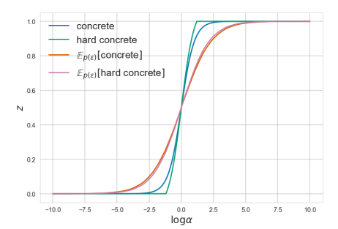
LEARNING SPARSE NEURAL NETWORKS THROUGH L0 REGULARIZATION
Louizos et al. [2] proposed a method for pruning the network during training by encouraging weights to become exactly zero. Since the L0 norm of weights is non-differentiable, they propose a solution through the inclusion of a collection of non-negative stochastic gates. They "stretched" a binary concrete distribution and then transformed its samples with a hard-sigmoid to obtain the hard concrete distribution for the gates.
[2] Christos Louizos, Max Welling, and Diederik P Kingma. Learning sparse neural networks through l 0 regularization. arXiv preprint arXiv:1712.01312, 2017.

Slide 65


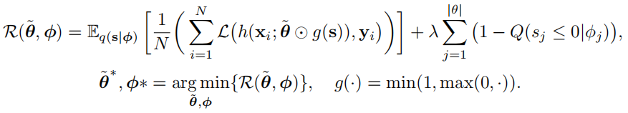
We can now let the gates z be given by a hard-sigmoid rectifi-cation of s, as follows:
This is easily obtained by the cumulative distribution function (CDF) Q(·) of s:
The above Eq represents the CDF of gates z which are not 0. We can add it as the regularization into the optimization objective to simplify the network.

Slide 66
Improving Deep Neural Network Sparsity through Decorrelation Regularization
Zhu et al. [3] investigate the deep neural networks trained by group LASSO constraint and observe that even with strong sparsity regularization imposed, there still exists substantial filter correlation among the convolution filters, which is undesired for a compact neural network. We propose to suppress such correlation with a new kind of constraint called decorrelation regularization, which explicitly forces the network to learn a set of less correlated filters.
[3] Zhu X, Zhou W, Li H. Improving Deep Neural Network Sparsity through Decorrelation Regularization[C]//Ijcai. 2018: 3264-3270.

Slide 67
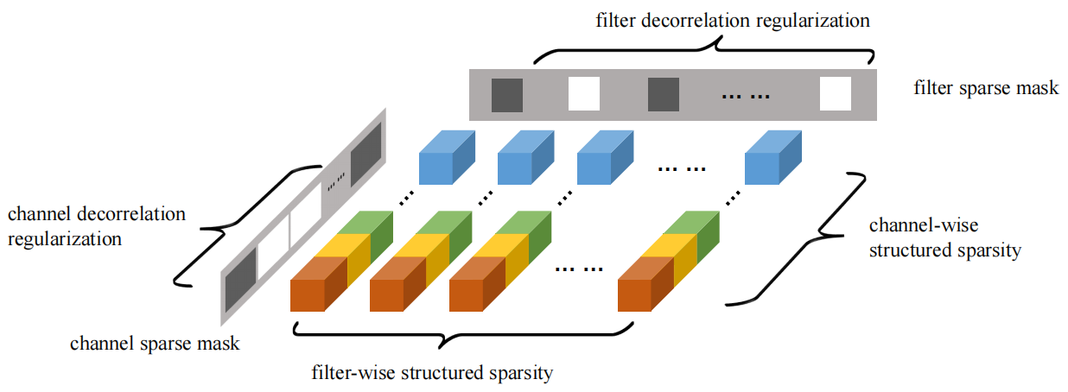
During the training process, a sparse mask is maintained for each layer, and we minimize the correlation of the filters which have not been masked. This regularization explicitly forces the network to learn a set of less correlated filters, and the sparse mask ensures that decorrelation regularization is only imposed to those indispensable filters.

Slide 68

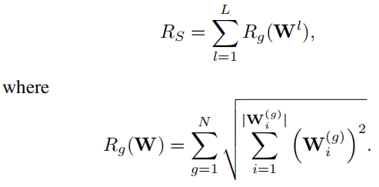
For a convolutional neural network, the convolution kernel in
layer l is a 4-dimensional tensor where Dl is the spatial size of the convolution kernel in layer l, Cl is the number of input channels, and Nl is the number of filters in layer l. The filter-wise structured sparsity in LASSO divides each weight tensor into N groups W(g) , g = 1, · · · , N, where each group contains the weights of one single filter:

Slide 69


A filter can be represented by other filters if it’s correlated with these filters, thus the filter correlation indicates the redundancy in the network. To measure the filter correlation, we define the mean filter correlation Corrl of the filters in layer l as:
where C is the Pearson correlation coefficient matrix, and Ci is the ith row of matrix C. The mean filter correlation of the whole network is then defined as:
Corr close to 1 means that most filters in the network are correlated. For a set of fully uncorrelated filters, the corresponding mean filter correlation should be zero.

Slide 70
Conclusions
Neural Architecture Search
Space, Strategy, Performance Estimation
Bayesian Network Structure Learning
Generative Learning
Knowledge Distillation
Teacher to Student
Network Compression based on Optimization Objectiveness
Sparsity Regulation

